Slide 1
NLP Overview, Regular Expressions and Byte-Pair Encoding
August 23rd, 2023
Dr. John D. Osborne

Slide 2
Lecture Overview
Assignment #1 – Coming soon…
Overview of NLP
Chapter 2 Regular Expressions, Text Processing, Byte-Pair Encoding
Regular expressions in NLP applications
FastContext (paper)

Slide 3
Regular Expressions Text Processing Byte-Pair Encoding Slides

Slide 4
Natural Language Processing
Definition
Natural Language
English
Spanish
Hindi
Processing
Input speech and text -> output something useful
Now usually with a computer…

Slide 5
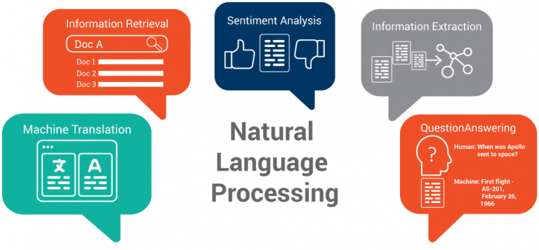
https://medium.com/greyatom/introduction-to-natural-language-processing-78baac3c602b
Notes:
Sentiment Analysis = Document Classification
Question Answering = Hardest Problem in NLP
Also speech recognition, authorship attribution, text generation/NLG

Slide 6
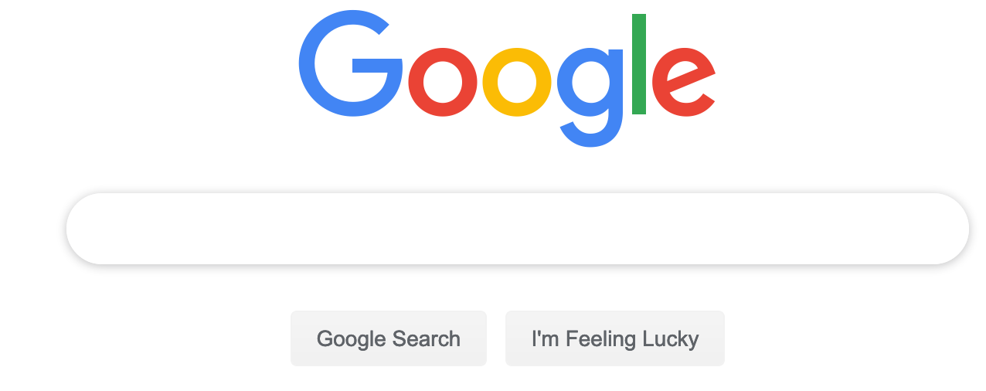
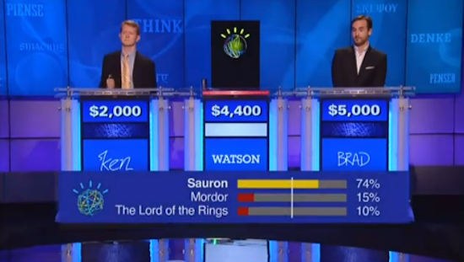
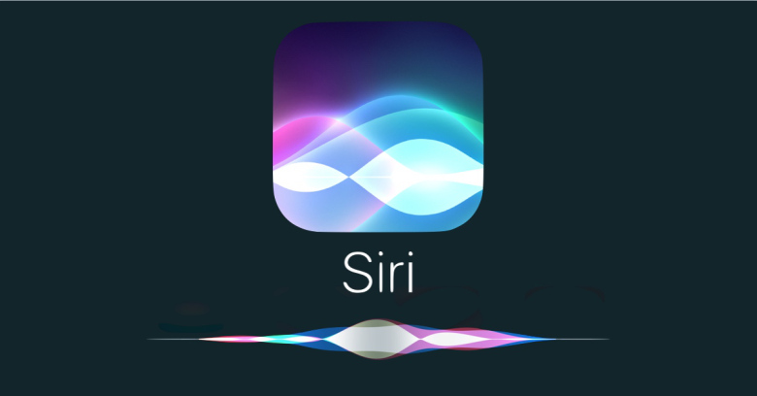
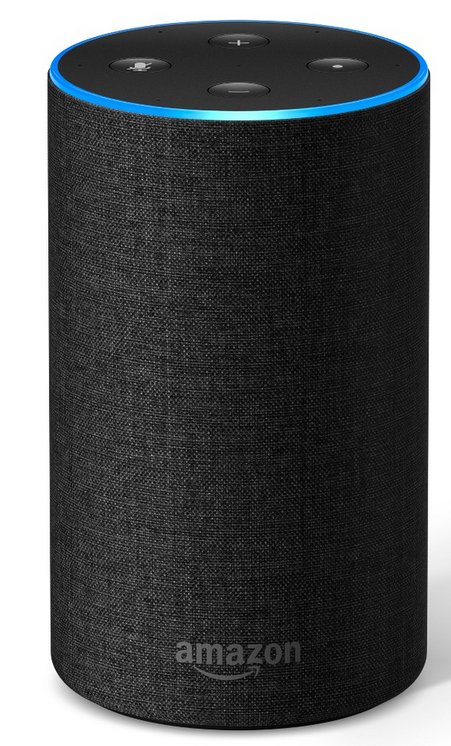
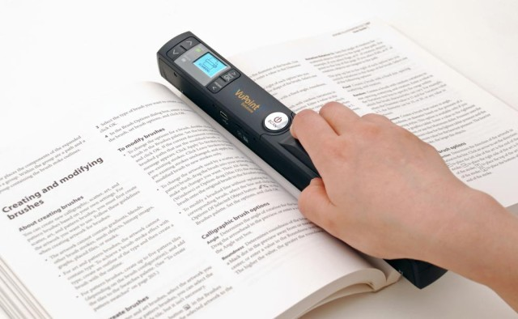

Notes:
2011
Watson wins Jeopardy
Iphone 4S includes Beta version of Siri

Slide 7
More is coming…
Better Language Models
Word Embeddings
Probability distribution over a sequence of words
Previously n-gram models, now neural network generated
Language Models are Unsupervised Multitask Learners, Radford et al 2019
NLP Course History
2018 – N-GRAM models
2019 – BERT
2020 – BERT descendants including GPT-2
2021 – GPT-3
2022 – PaLM / Gatortron
2023 – ChatGPT (released Nov 2022)
2024 - Llama2 and ???
Mikolov, Tomas, Ilya Sutskever, Kai Chen, Greg S. Corrado, and Jeff Dean. "Distributed representations of words and phrases and their compositionality." In Advances in neural information processing systems, pp. 3111-3119. 2013.
Originally word2vec, now better embedding software
Glove, ELMO, FLAIR
BERT: Pre-training of deep bidirectional transformers for language understanding, Devlin et al, 2018
Larger dimensionality and vocabulary
Notes:
BERT – Transformers taking over
ChatGPT – Scale/size, various improvements and RLHF, Generative

Slide 8
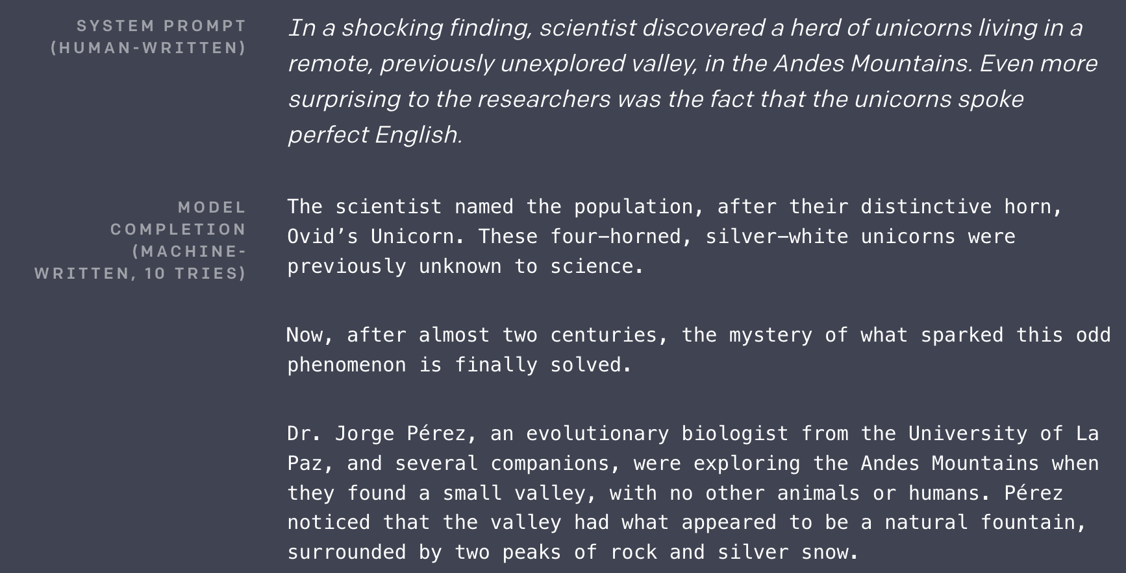
Notes:
GPT-2
“Recycling is good for the world. NO! YOU COULD NOT BE MORE WRONG!!”.
2019

Slide 9
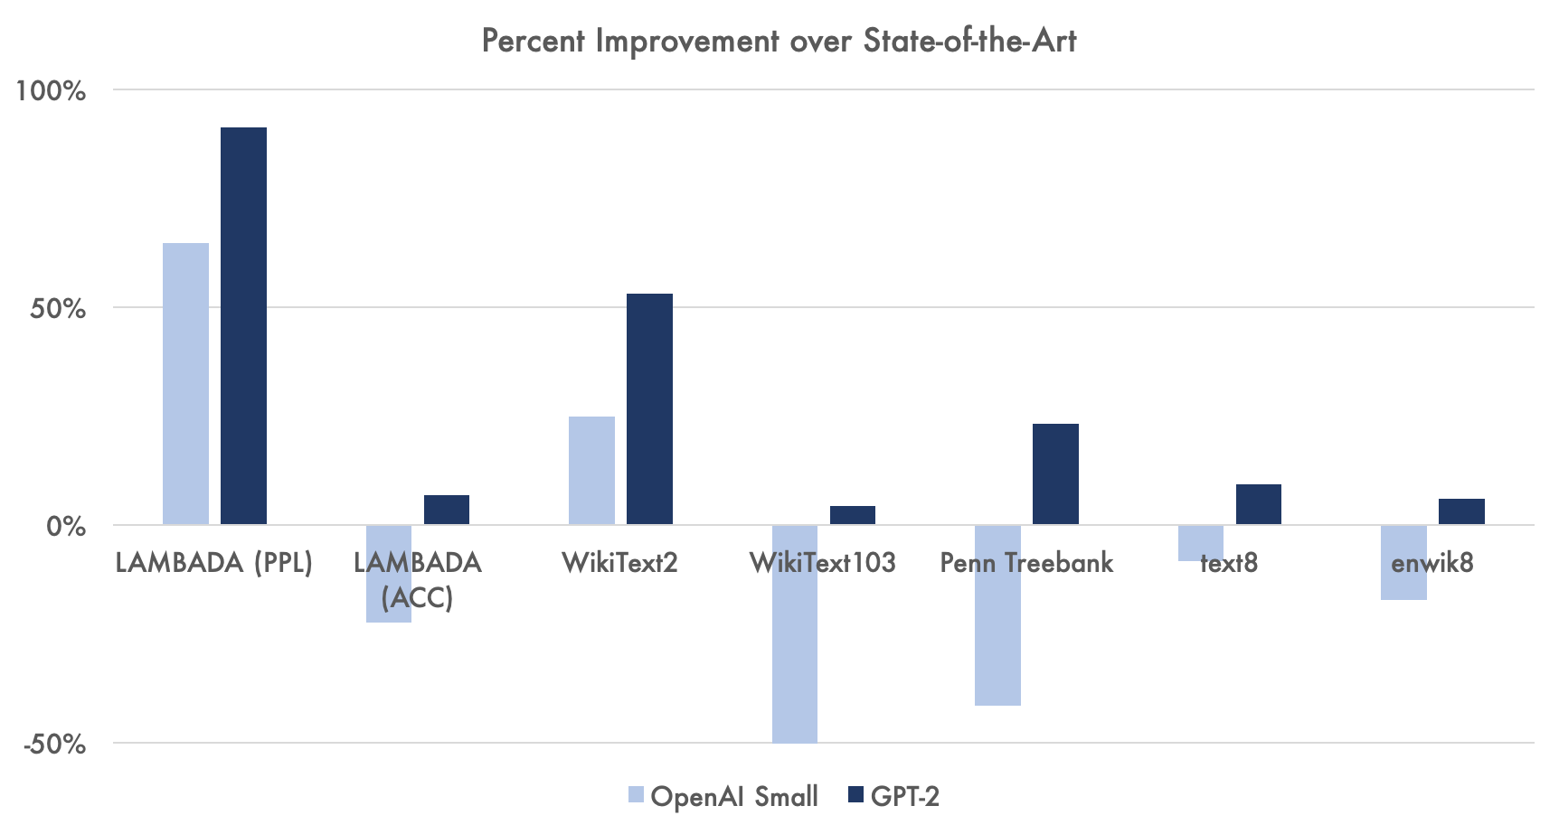
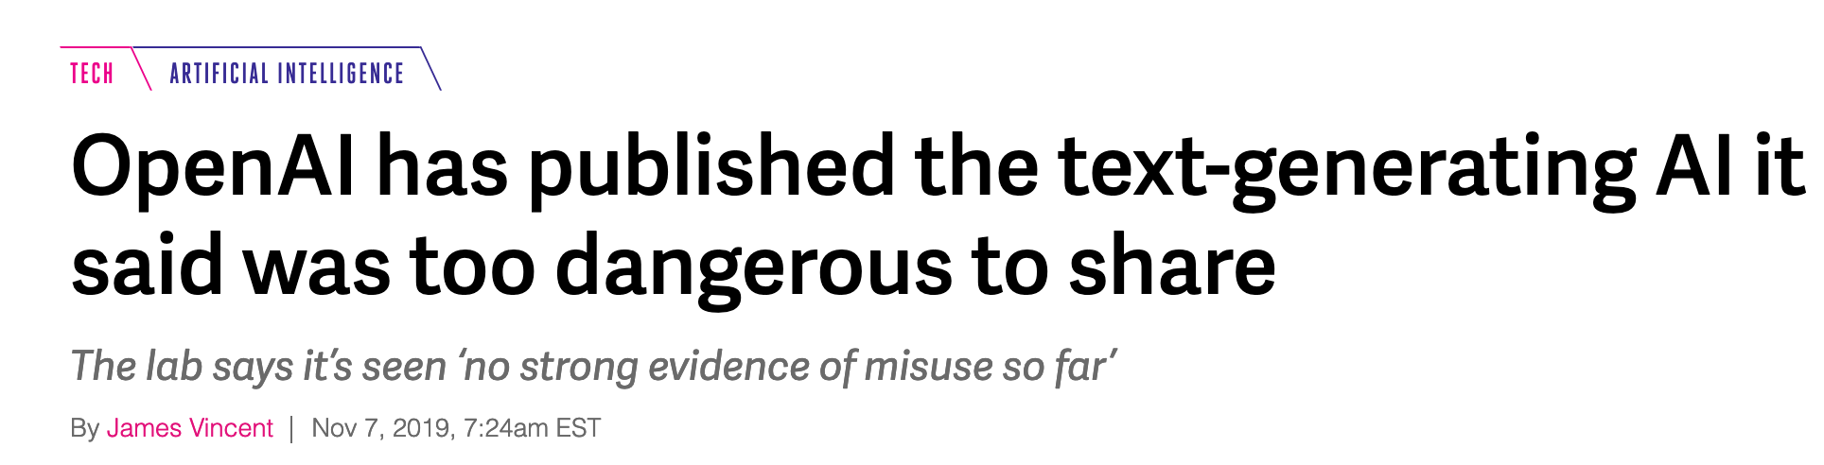
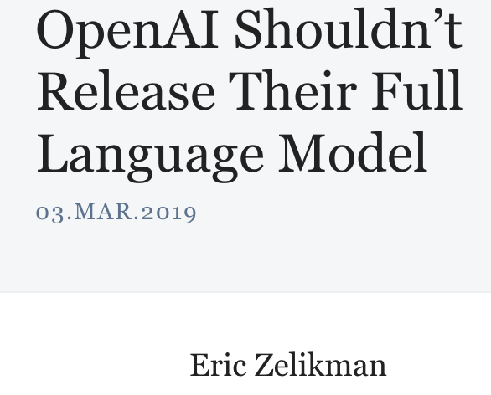
https://thegradient.pub/openai-shouldnt-release-their-full-language-model/
Notes:
They went on to publish it and share it.
Now with GPT-3 they are NOT sharing/publishing it!?! (OpenAI?)
Now GPT-4…

Slide 10
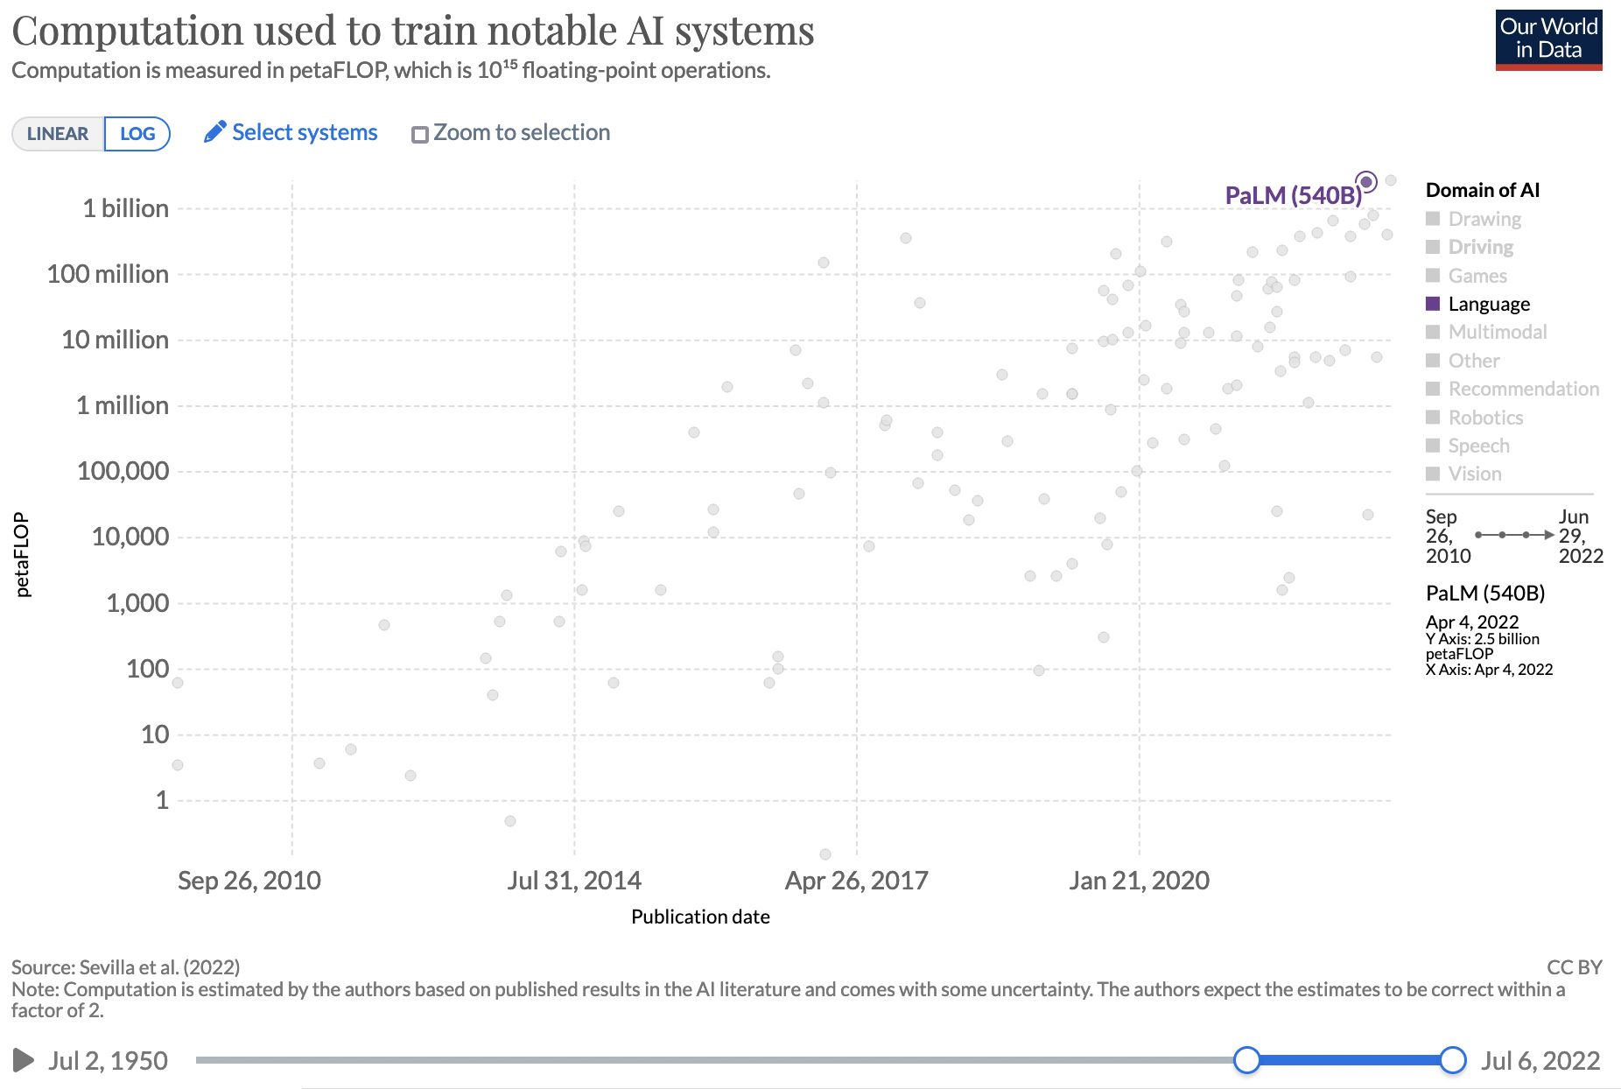
https://ourworldindata.org/grapher/ai-training-computation?time=2010-09-26..2022-07-01&country=~PaLM+%28540B%29
Notes:
Don’t have GPT-4 stats here, but it is… 170 trillion parameter model
Ask students – what is a parameter?k

Slide 11
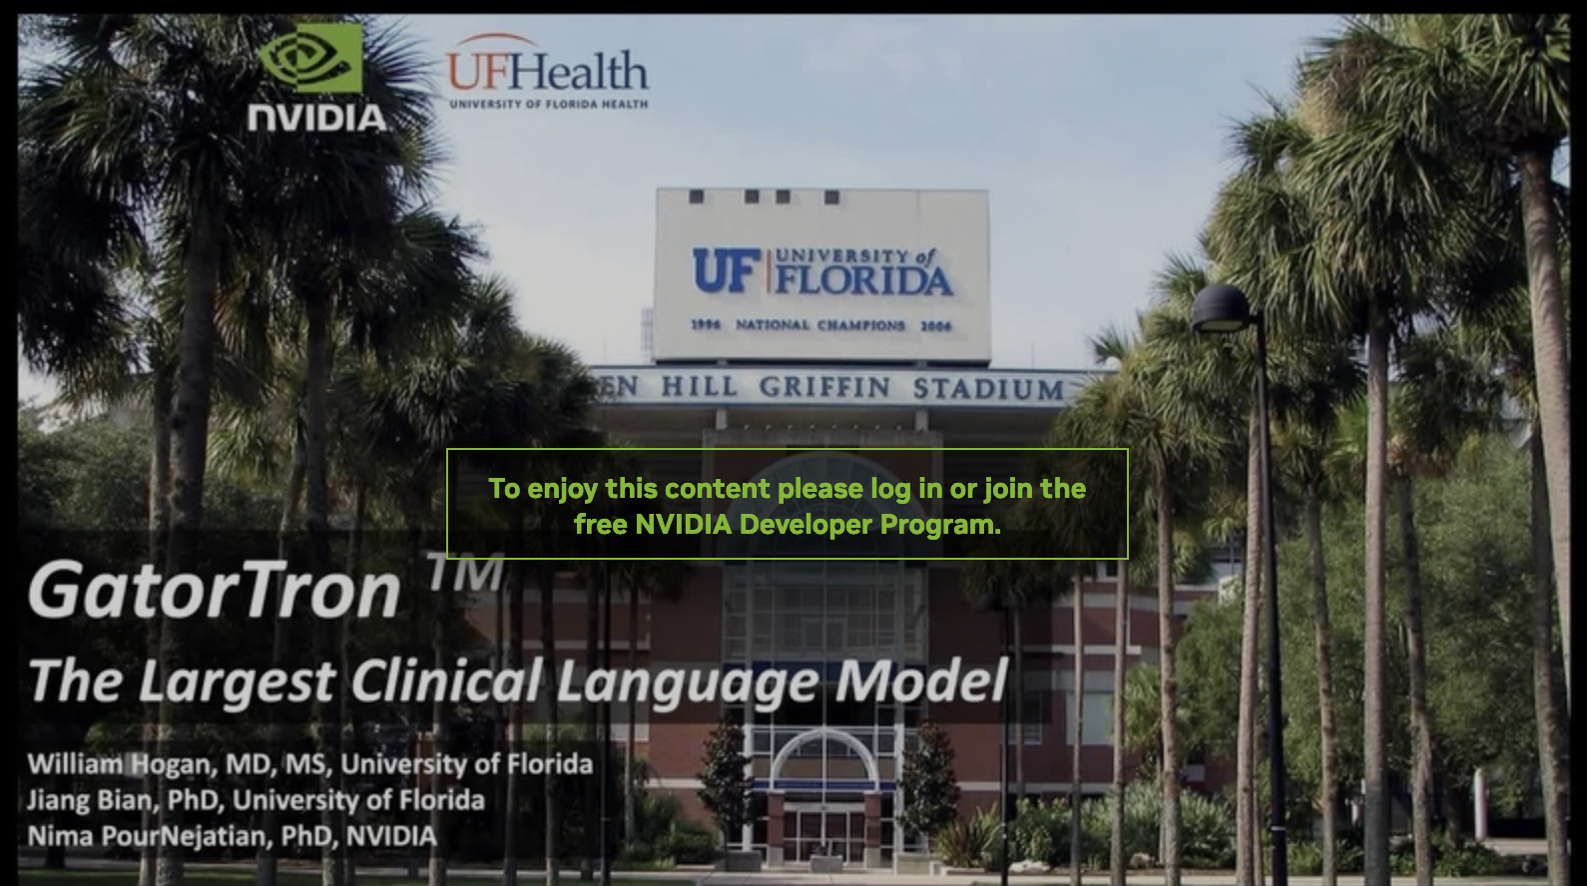
90 billion words (mostly clinical)
3 sizes of BERT from 345 million to 8.9 billion parameters
pretraining across a DGX SuperPOD with over 1,000 A100 GPUs…
Yang, Xi, Nima Pour Nejatian, Hoo Chang Shin, Kaleb Smith, Christopher Parisien, Colin Compas, Mona Flores et al. "GatorTron: A Large Clinical Language Model to Unlock Patient Information from Unstructured Electronic Health Records." medRxiv (2022).

Slide 12
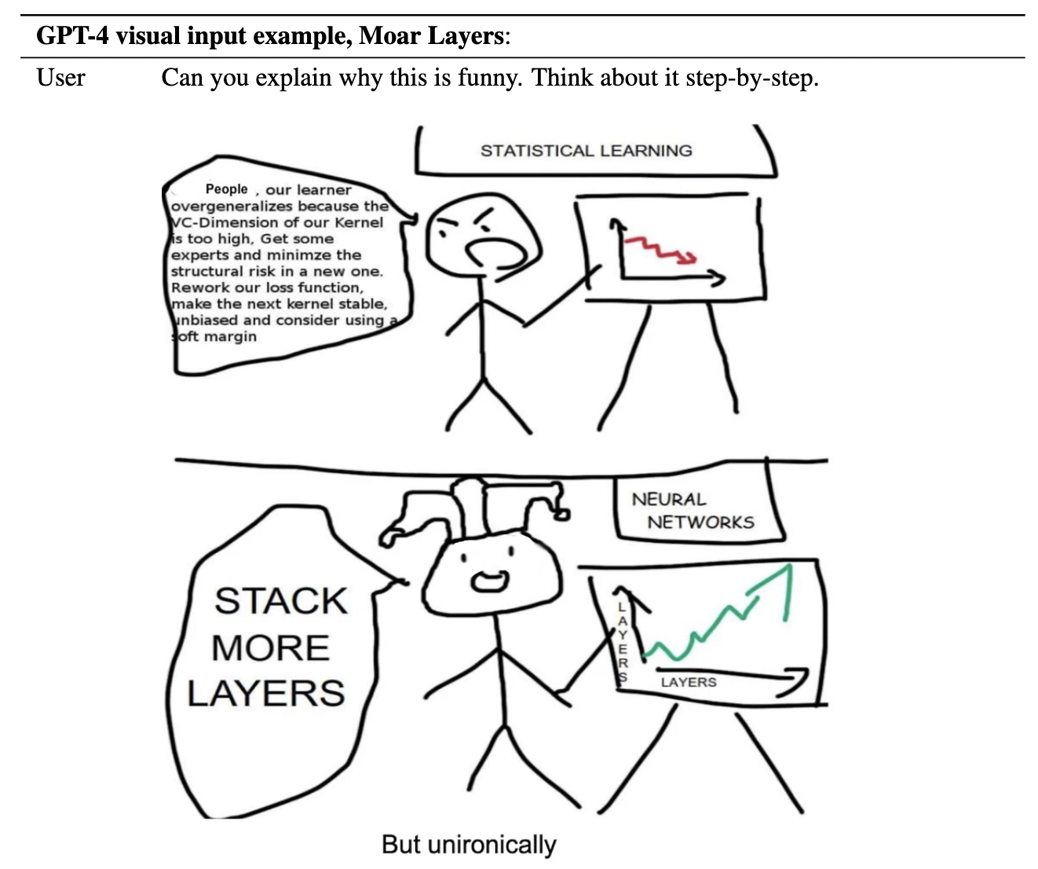
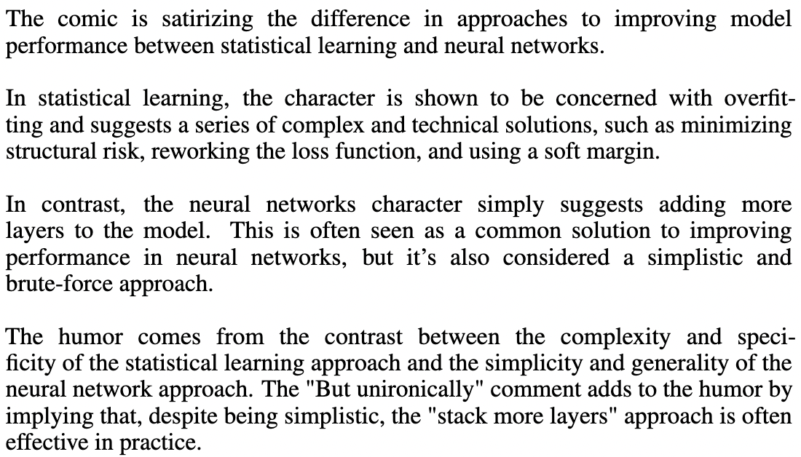
Notes:
Multi-modality here is just image and text
Future is video (already stuff out there) which has big implications for robotics

Slide 13
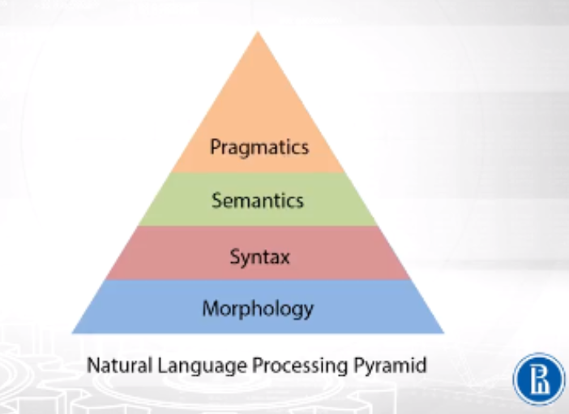
What are the components of Natural Language Processing?
Derived from Linguistics
Coursera Version definition
Anything missing?

Slide 14
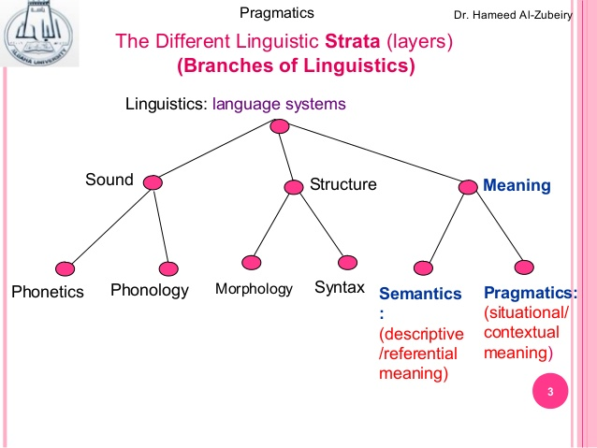
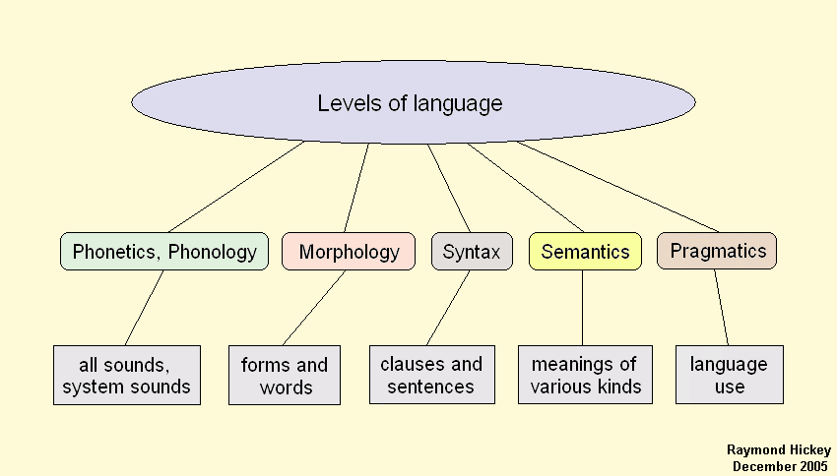
Other Opinions and Taxonomies?
Definitions have biases and boundaries, what this course covers as NLP will be no different…
Notes:
Phonetics, Phonology

Slide 15
Key Definitions
Phonetics
Phonology
Morphology
Syntax
Semantics
Pragmatics
Other than today, we will ignore phonetics and phonology…
Notes:
Students – you should at least know these definitions if you complete this course…

Slide 16
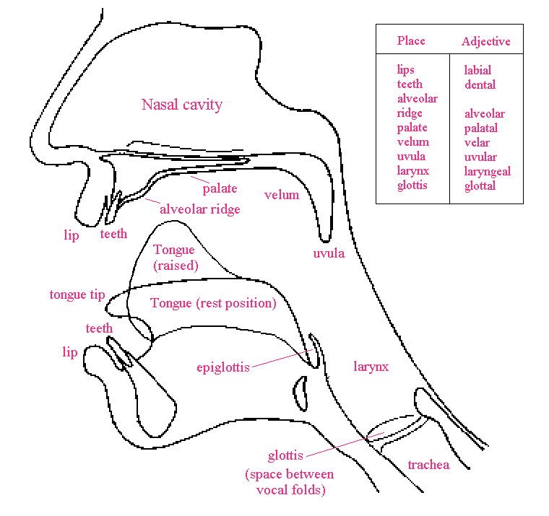
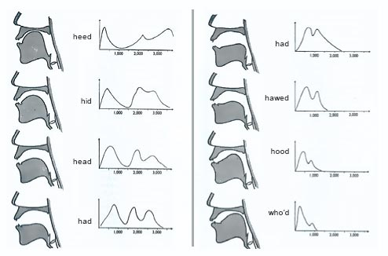
Phonetics – Sounds of Human Speech
https://www.uni-due.de/SHE/REV_PhoneticsPhonology.htm
Tongue placement as a filter in articulating vowel sounds. Ladefoged, 1996
Notes:
Articularly phonetics, Acoustic phonetics (do not memorize this stuff) – makes phones
Incomplete, auditory phonetics
Unrelated to human language whatsoever, 100% related to human body
Does NLP care? Speech recognition for someone who is disabled? Stroke victim?

Slide 17
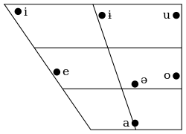
Phonology
Study of sound organization of languages
Different language speakers perceive different sounds differently
Not just relevant when doing audio processing or transcription
Spelling mistakes..
Soundex algorithm
Romanian Vowel Chart, Sarlin, Mika (2014)
Notes:
Vertical axis is vowel closeness (top of tongue), horizontal is vowel backwardness (back of mouth)
Only difference between vowels is where the tongue is when you say it
Not just different language, same language different dialects (Mr. Toad in high register RP, versus American/North English Mr. Toad), same set of phoenmes

Slide 18
Morphology
Studies internal structure of words using morphemes, the smallest lexical unit that has semantic meaning
Morphemes consist affixes or stems
Lexemes and word forms
Lemmatization/Stemming and Inflection
Tense
Case
Voice
Gender
Singular Plural
Utility?
Task specific ”word” counting
Medical neologisms
Language analysis, word borrowing
Spelling correction
Abbreviation detection
Notes:
Cardiovascular, unhappyness

Slide 19
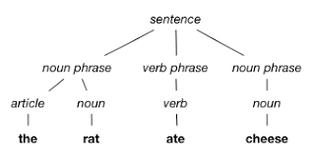
Syntax
“the way in which linguistic elements (such as words) are put together to form constituents (such as phrases or clauses) “
Webster’s definition
Sentence identification
Part of Speech Tagging
Chunking
Parsing

Slide 20
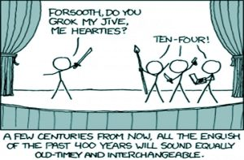
Semantics
The study of meaning
Some important tasks
Named Entity Recognition (NER)
Concept Normalization
Extremely important in biomedical domain
Relationship extraction
http://writeworksediting.com/its-just-semantics/

Slide 21
Pragmatics
Understanding of the text in its entire context
Who?
Where?
When?
Tasks
Question answering
Better language translation
Text generation and summarization
Coreference resolution / anaphora
Notes:
“Nearest restaurant”

Slide 22
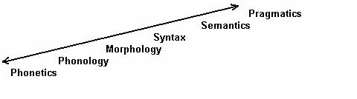
NLP Pipeline
Start the bottom (or where you need to) and work your way up

Slide 23
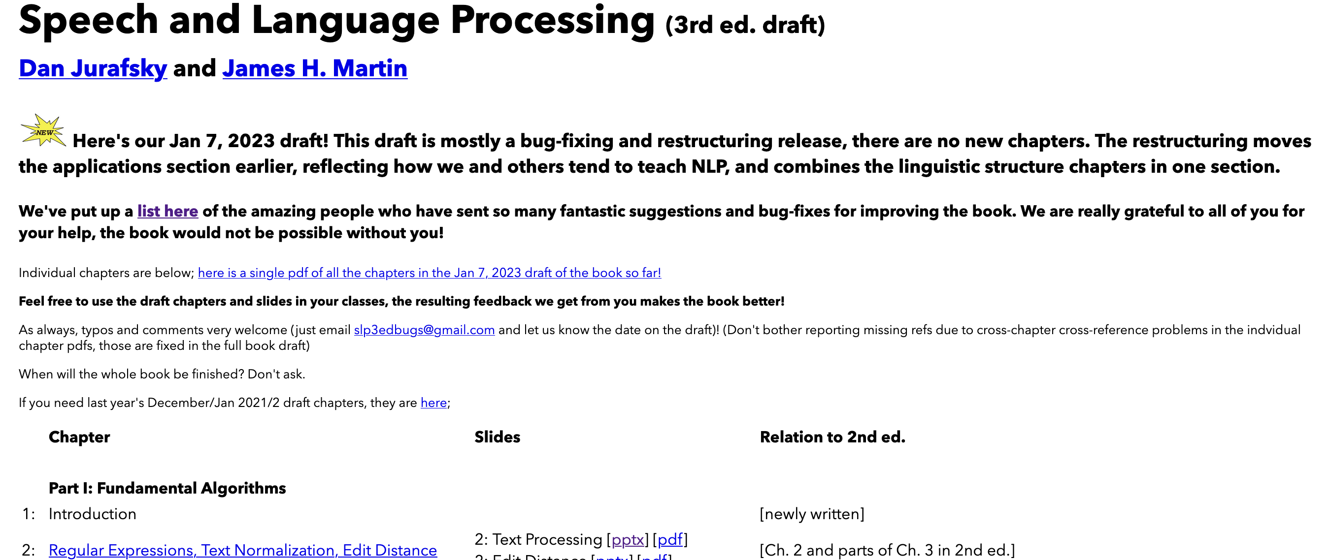
Chapter 2
https://web.stanford.edu/~jurafsky/slp3/

